Slide 1


AgentHack: The Art of AI Embodiment: Real-Time Interactive Experiences with Azure OpenAI GPT-4o and 3D Avatars
Cedric Vidal
Principal AI Advocate
linkedin.com/in/cedricvidal
April Speight Principal Cloud Advocate, AI
linkedin.com/in/aprilspeight

Slide 2
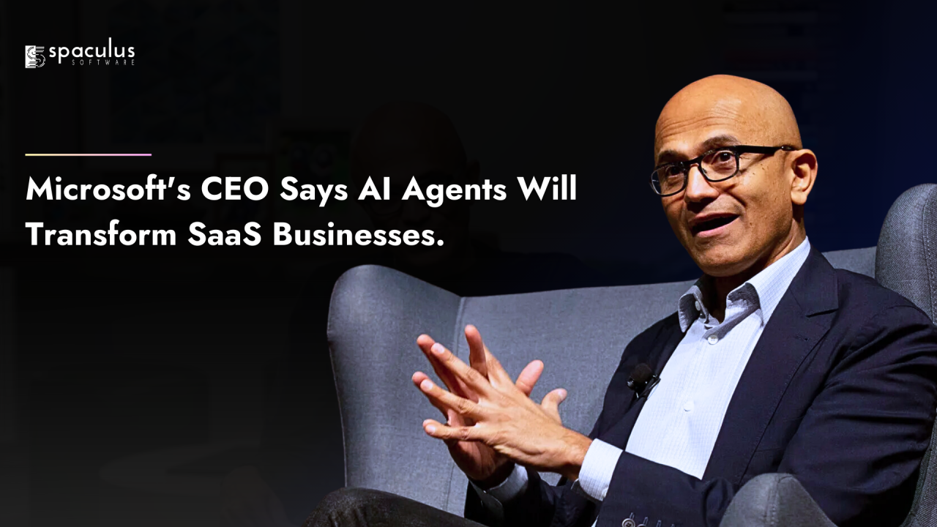
Current State of Agentic Systems
“Agents will replace all software” – Satya Nadella
“SAAS is dead”
Agentic systems are evolving rapidly with AI advancements.
Applications span various industries, showcasing versatility.
Notes:
Agentic systems have made significant strides due to advancements in AI technology. They are now capable of more complex real-time interactions, enhancing user engagement across various applications. The versatility of these systems allows for implementation in multiple industries, from healthcare to customer service. As these technologies evolve, ongoing research is crucial to address ethical considerations and ensure responsible use.

Slide 3
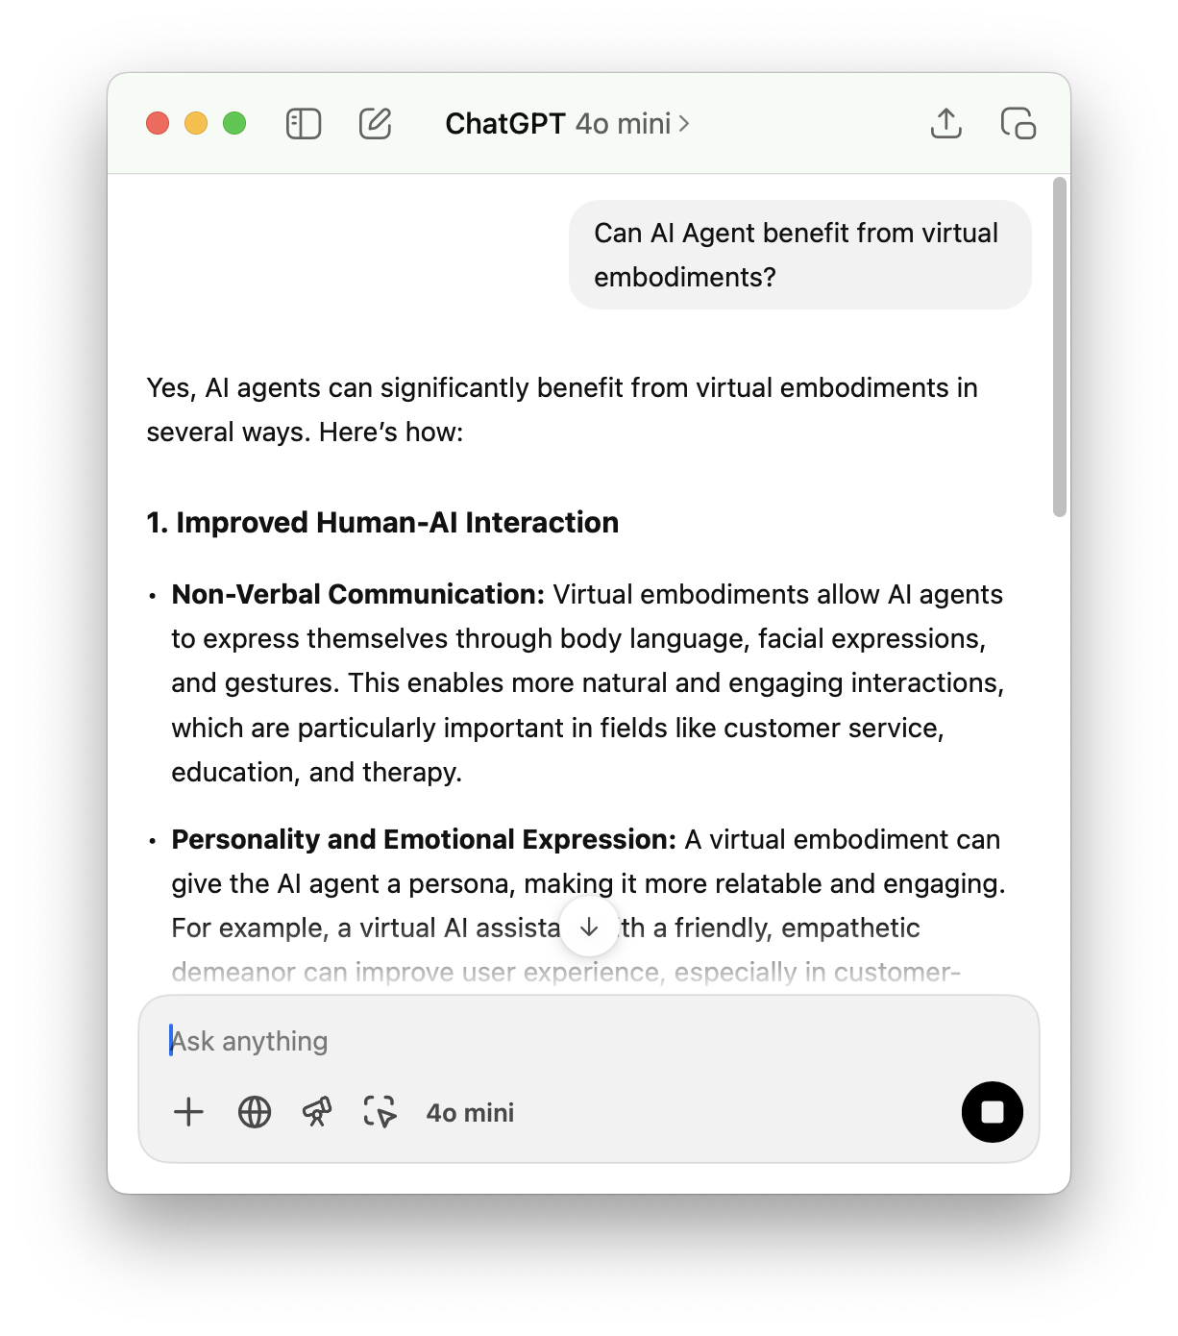
Limitations of Current Agentic Systems
Lack of Non-Verbal Communication
Limited Emotional Expression
Difficulty in Contextual Understanding
Reduced User Engagement
Notes:
Now, let’s discuss some of the key limitations of current chat-based AI agents and how virtual embodiment can help address these challenges:
Lack of Non-Verbal Communication:
Traditional chat-based AI relies solely on text, which means it misses out on the rich layers of communication that come with non-verbal cues—like body language, facial expressions, and gestures. Virtual embodiment can bridge this gap by allowing the AI to communicate more naturally, just like humans do in face-to-face conversations.
Limited Emotional Expression:
Chat-based AI often struggles to convey empathy, tone, and personality. As a result, interactions can feel mechanical and disconnected. With a virtual embodiment, the AI can use facial expressions and tone of voice to express emotions and empathy, making the conversation feel more human-like and emotionally engaging.
Difficulty in Contextual Understanding:
Chat-based AI can have a hard time understanding the full context of a conversation, such as interpreting tone or mood from text alone. This can lead to misunderstandings or inappropriate responses. Virtual embodiment allows the AI to pick up on visual cues, such as the user’s body language or expressions, improving the contextual understanding and making responses more relevant and sensitive.
Static and Predictable Interactions:
Without embodiment, chat-based AI is often limited to pre-set responses and lacks dynamic adaptability. Virtual embodiment brings fluidity to the interaction, enabling the AI to respond in real-time with varied expressions, movements, and gestures, just like a human would, making the experience more interactive and engaging.
Reduced User Engagement:
Text-only interfaces can sometimes feel impersonal and detached, especially when the task requires emotional intelligence or social interaction. By adding virtual embodiment, the AI agent becomes more engaging, helping users feel like they’re interacting with a relatable entity, increasing trust and overall satisfaction in the process.
In summary, virtual embodiments help AI agents overcome these limitations by adding depth, expressiveness, and contextual awareness, leading to more natural and engaging interactions.

Slide 4
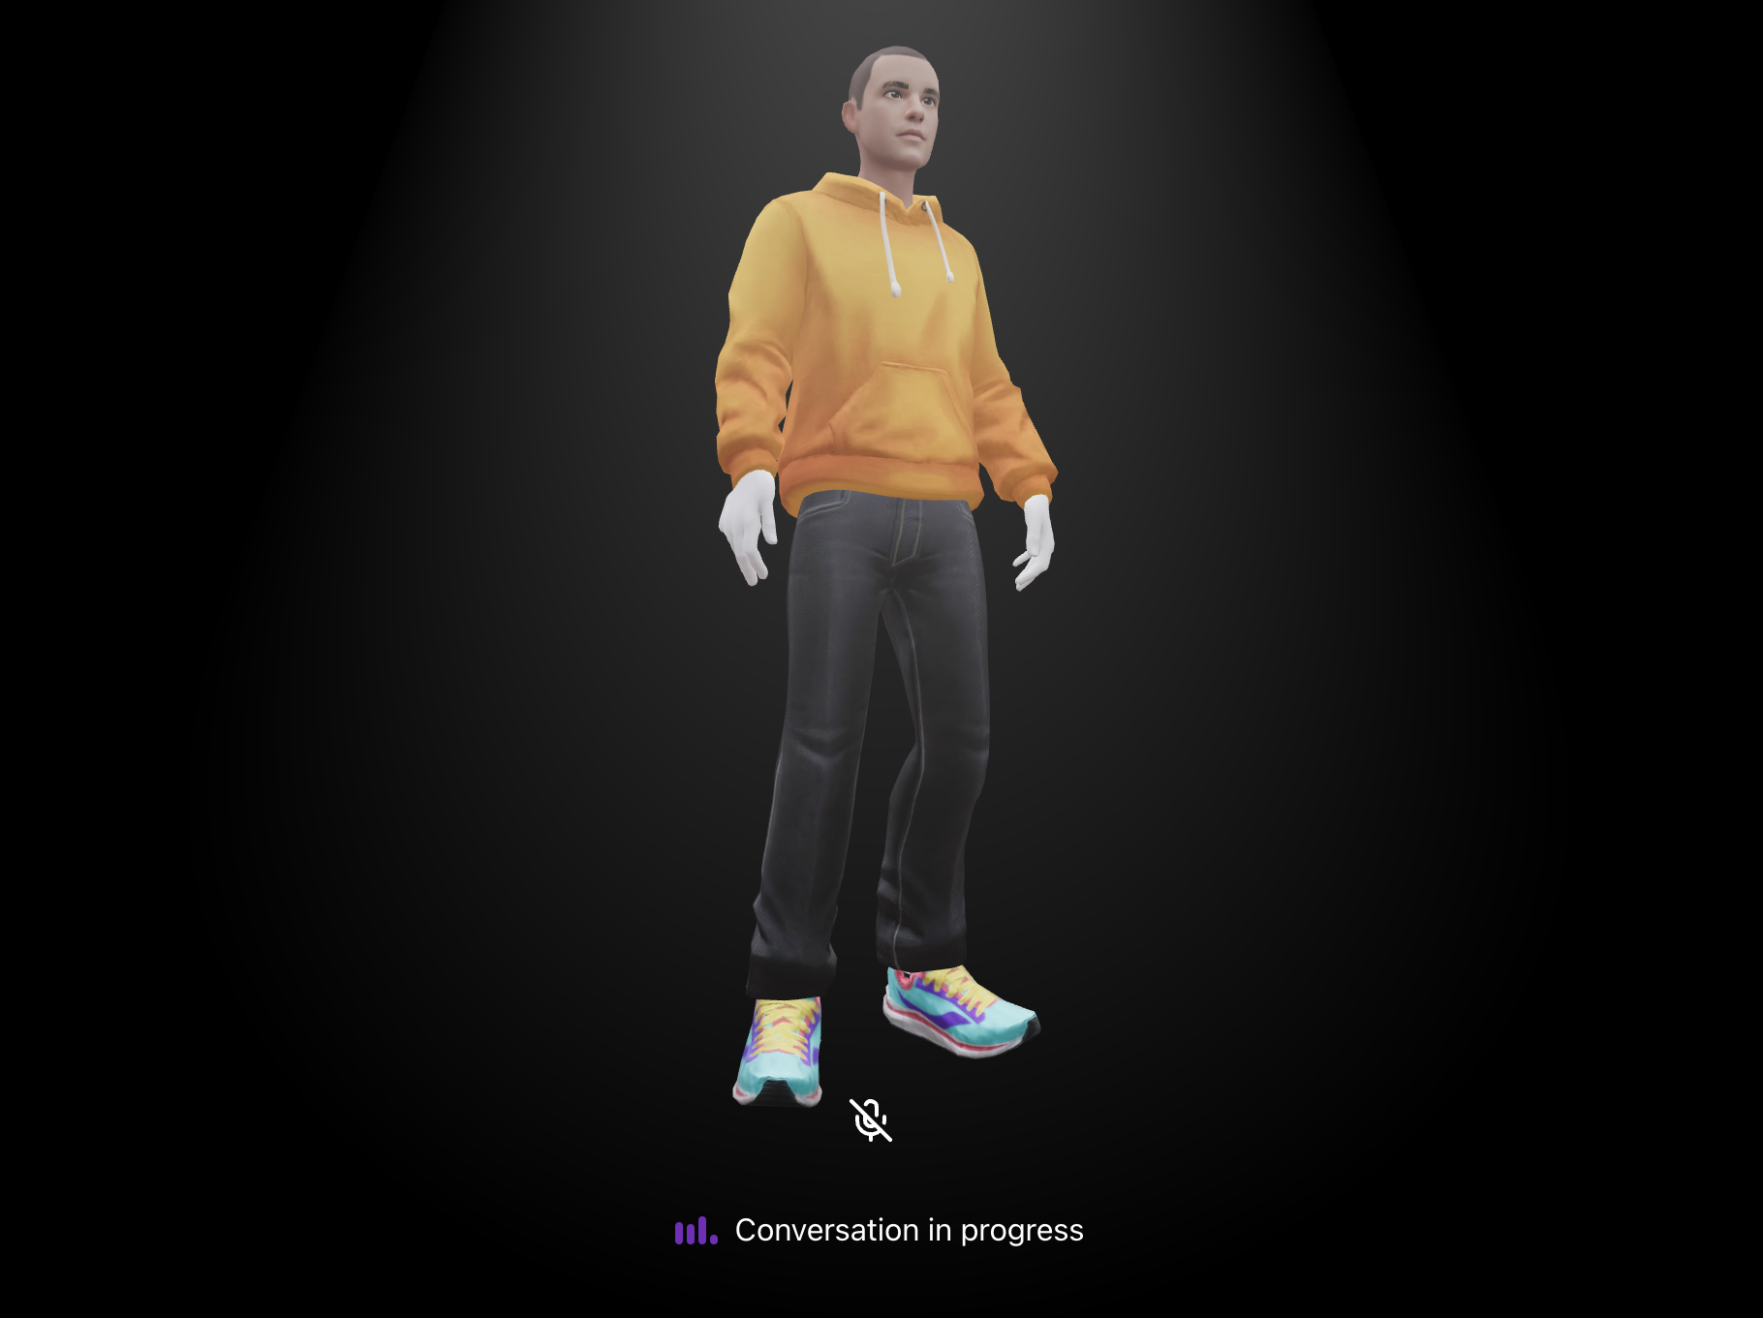
Enhancing User Engagement with AI Embodiment
Enhanced Human-AI Interaction
Multimodal Engagement
Contextual Awareness
Improved User Trust and Engagement
Scalable and Versatile Applications
Notes:
Bullet Points:
Enhanced Human-AI Interaction
Virtual embodiment enables non-verbal communication, improving the natural flow of interaction.
Multimodal Engagement
Combines voice, gesture, and visual cues for a more intuitive and immersive experience.
Contextual Awareness
AI agents can respond to environmental cues, improving context-sensitive responses.
Improved User Trust and Engagement
A relatable AI persona fosters trust and increases user satisfaction in various applications.
Scalable and Versatile Applications
Virtual embodiments can be easily adapted across different platforms, from mobile to VR.
Script:
“Today, I want to explore how virtual embodiment can significantly enhance AI agents, bringing them closer to human-like interactions.
Enhanced Human-AI Interaction:
Virtual embodiment allows AI agents to communicate not just through words, but through non-verbal cues—like gestures and facial expressions. This makes the interaction more natural and engaging for the user, much like conversing with another human.
Multimodal Engagement:
One of the key benefits of embodiment is the ability to combine voice, gesture, and visual signals. This multimodal communication mirrors human interaction, helping the AI agent respond in a way that feels more intuitive, responsive, and personalized.
Contextual Awareness:
With a virtual embodiment, AI agents gain the ability to process and react to environmental context—whether it’s adjusting their responses based on the user’s actions or the surrounding environment. This adds a layer of sophistication that can make AI more effective, particularly in dynamic or complex settings.
Improved User Trust and Engagement:
An embodied AI feels more like a ‘companion’ than a mere tool, which increases trust and engagement. Whether in customer service or educational settings, users are more likely to connect with and rely on an AI that feels familiar and responsive.
Scalable and Versatile Applications:
Lastly, virtual embodiments are highly adaptable. They can work across different platforms—mobile apps, desktop interfaces, VR/AR—allowing AI agents to provide consistent experiences across diverse devices and environments.
In conclusion, adding virtual embodiment to AI agents brings more human-like interaction, improves user engagement, and opens up new possibilities for how AI can be used effectively across industries.”

Slide 5






Overview of the architecture
Frontend
Backend
Azure AI
RTClient
RTMiddleTier
Azure OpenAI GPT 4o Realtime API
Animation Tool
RAG Tool
Azure AI Search
Avatar
(ThreeJS Fiber Canvas)

Slide 6
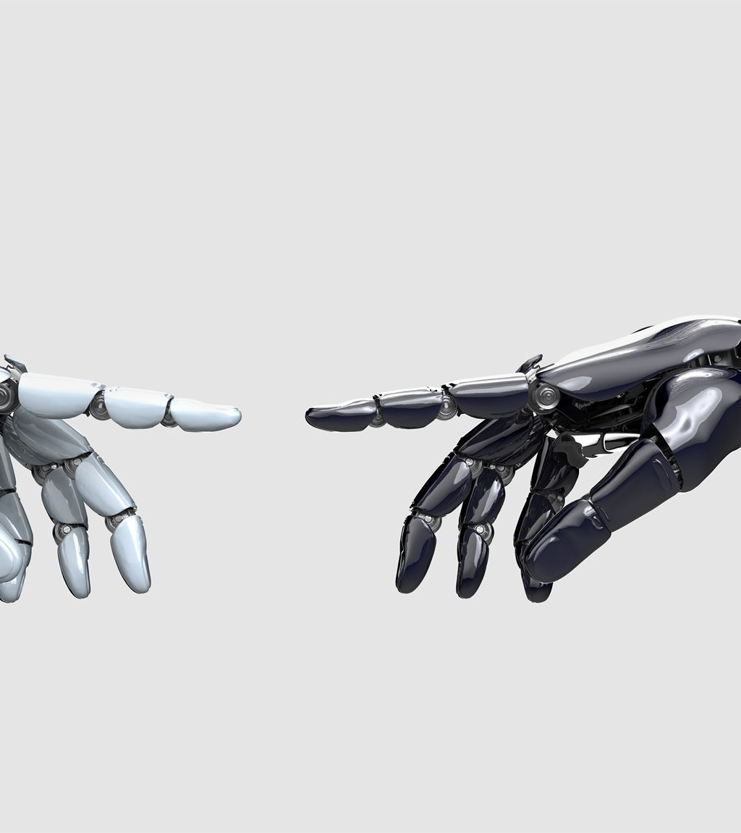
Demonstrating AI Embodiment
Showcase interactive agent responding to user queries.
Highlight real-time feedback and adaptability.
Demonstrate emotional expressions and animations.
Notes:
This slide presents a demo of the AI embodiment approach. We'll showcase an interactive agent that can respond to user queries in real-time. We'll highlight the adaptability of the agent and demonstrate emotional expressions through animations. After the demo, we'll present user engagement statistics and gather feedback for future enhancements.

Slide 7

Limitations of AI Embodiment presented here
GPT-4o Realtime is currently in preview mode.
The technology is not yet production ready for widespread use.
Lack of lip syncing affects realistic conversations.
Absence of facial expressions limits emotional engagement.
Interactivity is constrained by these technological gaps.
Notes:
This slide highlights key limitations of the AI embodiment approach. The GPT-4o Realtime is still in its preview phase, meaning it lacks the stability and reliability needed for production use. Moreover, the absence of lip syncing and facial expressions significantly detracts from creating a truly interactive and immersive experience.

Slide 8
Unlocking New Possibilities
Animation
Interaction
Communication
Making movements more natural and expressive
Enabling real-time responses to users and environments
Improving conversation flow, tone, and memory
Real-time lip sync
Facial expressions
Blinking animations
Eyebrow movement
Head nods or tilts
Gaze tracking
Gesture animations
Idle animations
User name recognition
Emotion mirroring
Environmental reactions
Conversational memory
Tone of voice selection
“Thinking” animation
Interruptible speech
Multiple TTS voices

Slide 9
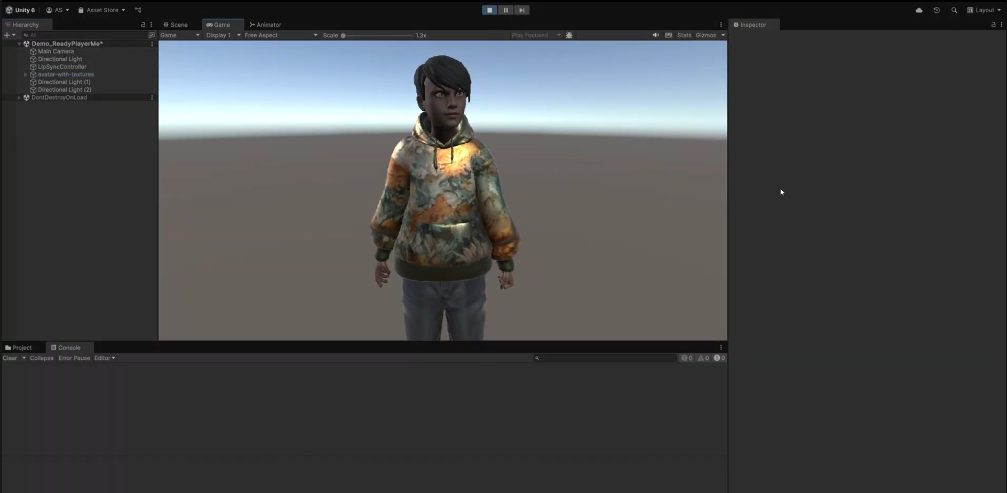

Ready Player Me Avatar with Lip-Sync and Facial Expressions
Avatar 2.0
New Features Added:
Real-time lip sync
Facial expressions
Idle animation

Slide 10

Demo

Slide 11
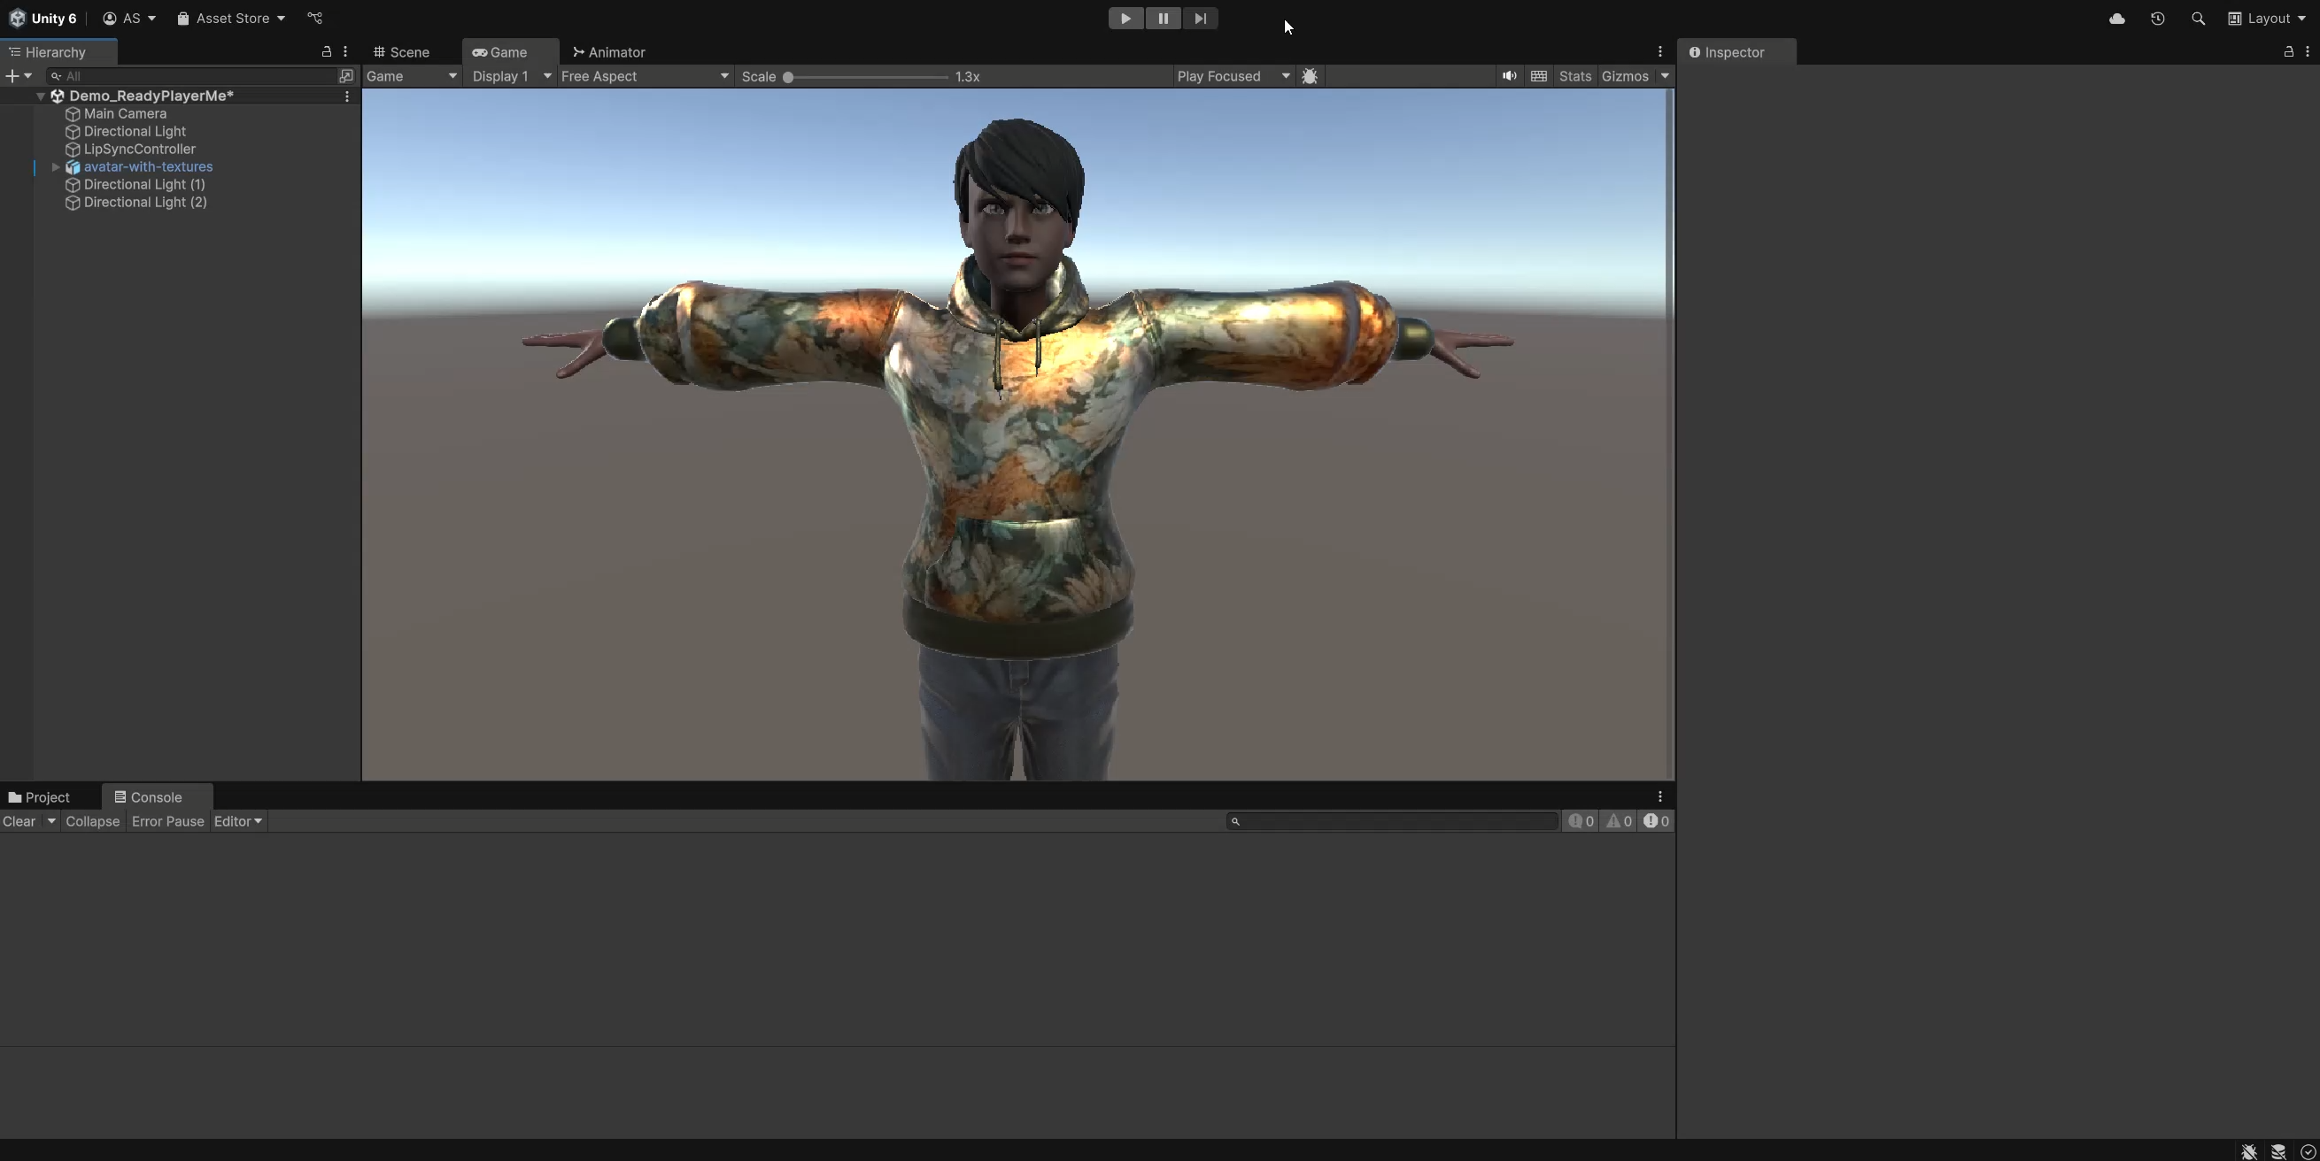

Slide 12



Tech Stack Overview
Model
Development Platforms
GPT-4o
Azure AI Foundry, Unity
Animation & Audio Tools
Mixamo, SALSA LipSync Suite, Eleven Labs Text-to-Speech
Avatar Framework
Ready Player Me

Slide 13
Bringing it All Together
Text-to-Speech
Model
ELEVEN LABS
User Prompt
Speech-to-Text
VOICE: NIA DAVIS
Tell me an interesting fact about space.
AZURE AI SPEECH
GPT-4o
RETRIEVAL
GENERATE RESPONSE
Audio Clip
SAVE LOCALLY
Unity
PLAY AUDIO
SALSA LIPSYNC

Slide 14
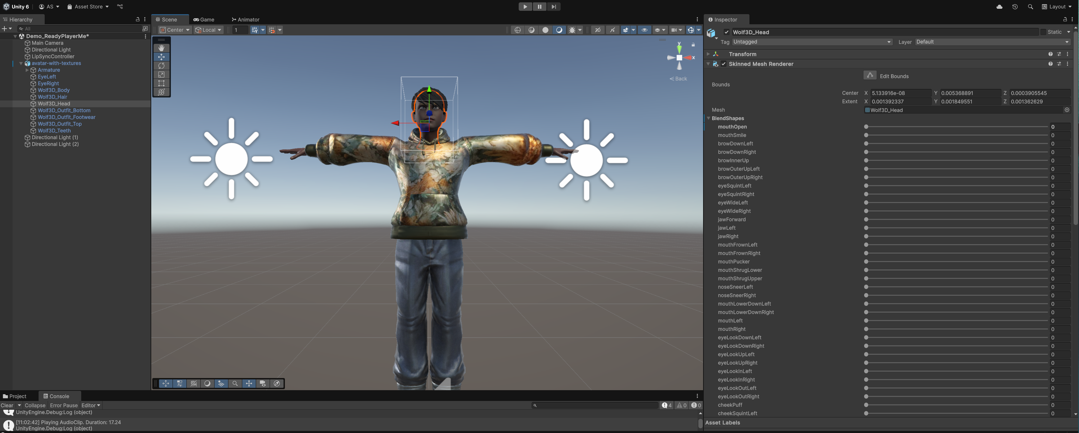

Slide 16
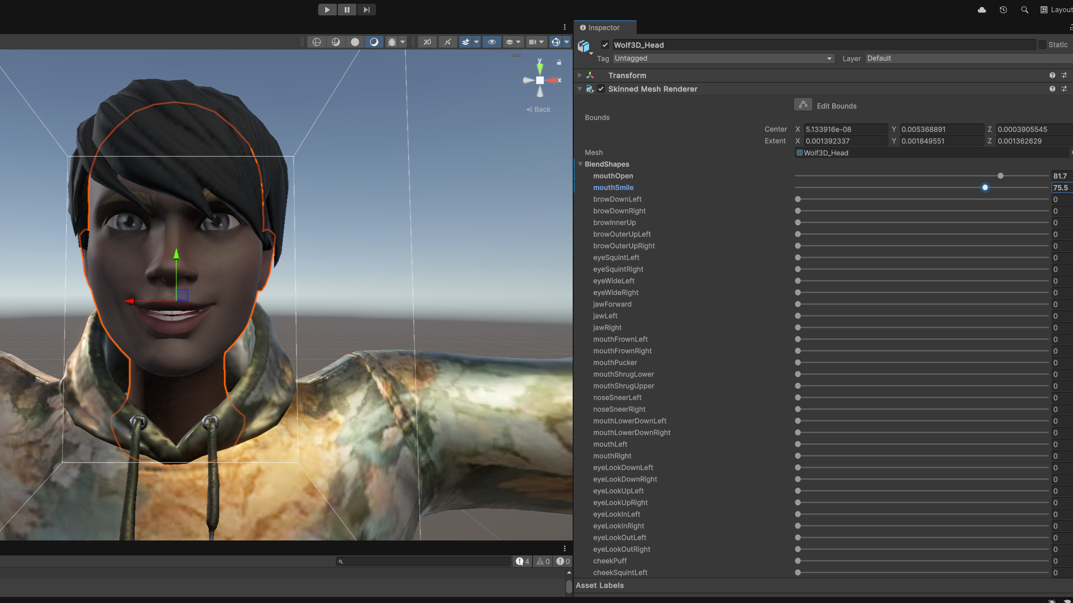

Slide 17
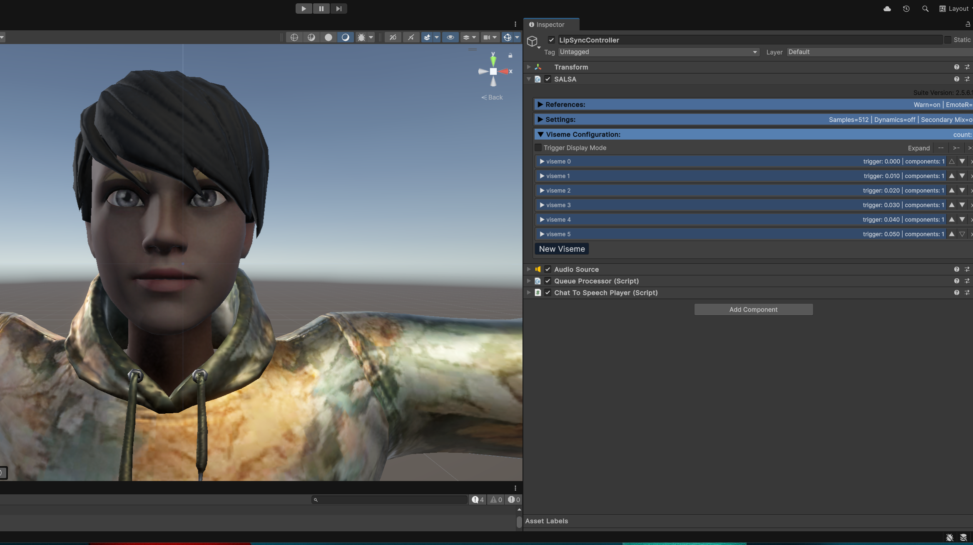

Slide 18
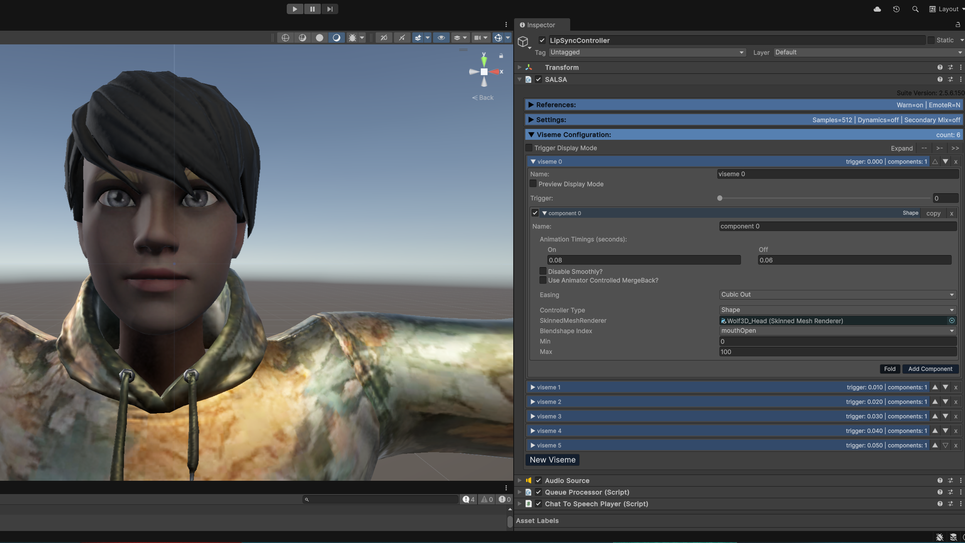

Slide 19




Insights & Key Learnings
Technical
Design
User Experience
Future Improvements
“Blend shapes” are useful for animating facial features
.fbx files contain blend shapes
Intensity of a mouth shape can be controlled programmatically
Avatar animations should play synchronously when a message is received; don’t revert to T-pose
Add a “thinking” animation to “disguise” latency
Hard coding the prompt is OK for testing however, users should have a way to interact dynamically
Opportunity to reduce latency
Design a UI for engaging with the avatar
Add Speech-to-Text for prompt input
Add more avatar animations with triggers
Improve lip sync

Slide 20

Real-World Applications
Imagining how intelligent avatars can transform everyday experiences
Education
Retail
Healthcare
Virtual tutors
Language learning companions
Campus tour guides
Career coaching assistants
Virtual store assistants
Personal stylists
Product demos
Customer support agents
Patient intake avatars
Therapy companions
Healthcare training simulations
Post-care check-ins
Entertainment
Workplace Solutions
Social & Community
Azure AI Translator
Game characters
Fan interaction avatars
Virtual concert hosts
Interactive storytelling
Employee onboarding assistants
Corporate training avatars
Internal helpdesks
Meeting facilitators
Virtual friends for seniors
Community event guides
Language exchange partners
Support group hosts
Personal assistant

Slide 21

Two approaches
React/Three.js
Unity
Web first, Typescript, no lip syncing
C#, game engine, real-time lip-sync

Slide 22
https://aka.ms/ai-body-repo
Get started with building agents and real-time experiences
Get started with the Azure AI Foundry: ai.azure.com
Learn more about GPT-4o Realtime Speech API https://aka.ms/c/learn/gpt4o-rt-speech
Learn more about Azure AI Agent Service on Microsoft Learn: https://aka.ms/MicrosoftLearn_Agents
Watch the Reactor sessions on-demand https://microsoft.github.io/AI_Agents_Hackathon/
Download this deck https://aka.ms/ai-body-slides
Checkout the Github repo https://aka.ms/ai-body-repo
Star the repo for the Unity approach https://github.com/aprilspeight/ai-avatar

